Slide 1
Randomized Controlled Trial (RCT)
Khezri.rojan@yahoo.com
12/25/2024 Rozhan Khezri 1

Slide 2
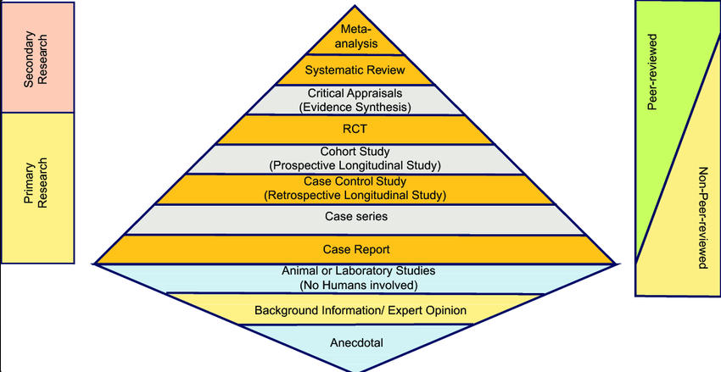
12/25/2024 Rozhan Khezri 2

Slide 3
Trials
Randomised Control Studies
Non-randomised concurrent control studies
Historical control / databases
Crossover designs
Withdrawal studies
Factorial designs
Group Allocation designs
Hybrid designs
Large Simple Clinical Trials
12/25/2024
Rozhan Khezri
3

Slide 4
What is a clinical trial
Prospective
Intervention
Control
Studies on human beings
12/25/2024 Rozhan Khezri 4

Slide 5
Clinical Equipoise
12/25/2024 Rozhan Khezri 5

Slide 6
What is a clinical trial
Early phase studies may be controlled or uncontrolled. Although common terminology refers to phase I and phase II trials, because they are sometimes uncontrolled, we will refer to them as clinical studies.
12/25/2024
Rozhan Khezri
6

Slide 7
What is a clinical trial
These may be single or combinations of diagnostic, preventive, or therapeutic drugs, biologics, devices, regimens, procedures, or educational approaches.
12/25/2024
Rozhan Khezri
7

Slide 8
PHASES OF DEVELOPMENT
12/25/2024 Rozhan Khezri 8

Slide 9
Phase I trial
Maximally Tolerated Dose, (MTD): how large a dose can be given before unacceptable toxicity is experienced by patients
DLT (Dose Limiting Toxicity)=1/3 unacceptable toxicity
12/25/2024 Rozhan Khezri 9

Slide 10
Phase I trial
3
If unacceptable toxicity is observed in any of the three patients, an additional number of patients, usually three, are treated at the same dose.
If no specified level of toxicity is observed, the next predefined higher dose level is used.
If no further toxicity is seen, the dose is escalated to the next higher dose.
If additional unacceptable toxicity is observed, then the dose escalation is terminated and that dose, or perhaps the previous dose, is declared to be the be the MTD.
12/25/2024 Rozhan Khezri 10

Slide 11
Phase II trials
A two-stage design
In the first stage the investigator attempts to rule out drugs that have no or little biologic activity
Gehan approach
1) n=14
2)n=20
12/25/2024 Rozhan Khezri 11

Slide 12
Phase III trials
Safety
Efficacy
Therapeutic confirmatory
12/25/2024 Rozhan Khezri 12

Slide 13
Phase IV
Chronic Conditions
Long-term Safety
12/25/2024 Rozhan Khezri 13

Slide 14
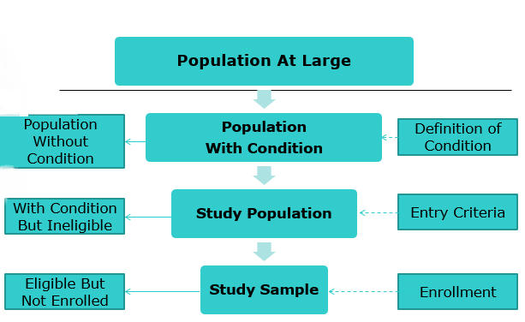
Phase III trials= RCT
12/25/2024 Rozhan Khezri 14

Slide 15
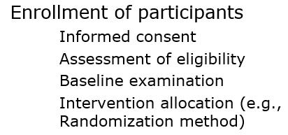
12/25/2024 Rozhan Khezri 15

Slide 16
Randomisation
Fixed Allocation Randomisation
Simple randomisation
Blocked randomisation
Stratified randomisation
12/25/2024
Rozhan Khezri
16

Slide 17
Simple Randomisation
Each participant has the same chance of being assigned to either intervention or control.
12/25/2024 Rozhan Khezri 17

Slide 18
Blocked Randomisation
Creating a balance in the number of samples allocated to each of the study groups.
12/25/2024 Rozhan Khezri 18

Slide 19
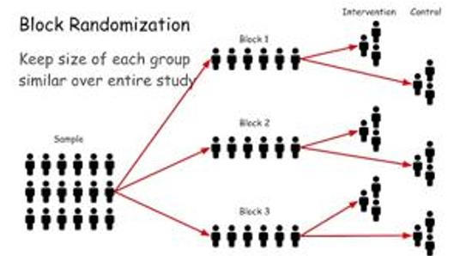
Blocked Randomisation
Fixed
Variable
12/25/2024 Rozhan Khezri 19

Slide 20
Stratified Randomisation
Stratified block randomization adds another layer by considering specific characteristics (strata) of participants, such as age or gender.
12/25/2024
Rozhan Khezri
20

Slide 21
The Benefits Of Randomization
Produce study groups comparable with respect to known and unknown
risk factors
Avoid bias(1. Selection bias . 2. Accidental bias )
12/25/2024 Rozhan Khezri 21

Slide 22
Blinding?
Bias
12/25/2024 Rozhan Khezri 22

Slide 23
Blinding
Unblinded trials
Single blind trials
Double blind trials
Triple blind trials
12/25/2024
Rozhan Khezri
23

Slide 24
RCT
Primary question
Secondary questions
Adverse effects
Ancillary questions, substudies
12/25/2024
Rozhan Khezri
24

Slide 25
RCT
Superiority vs. Noninferiority Trials
12/25/2024 Rozhan Khezri 25

Slide 26
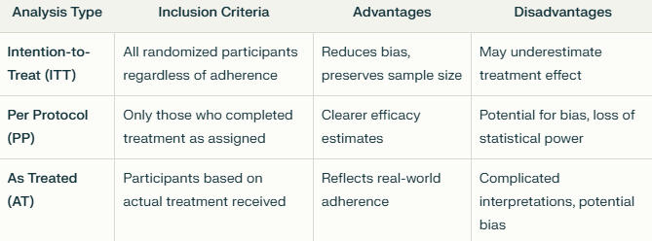
Main Methods of Analysis
12/25/2024 Rozhan Khezri 26

Slide 27
12/25/2024 Rozhan Khezri 27

